Slide 1
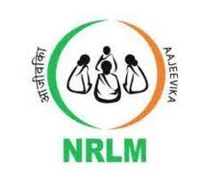
Case Study
Aajeevika
National Rural Livelihoods Mission (NRLM)

Slide 2
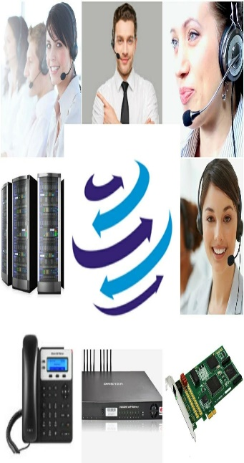
+91-856-00-00-600
www.dialerindia.com
avyuktaindia
CRM Based Dialer - IVR - Cloud Telephony
PRI Card - GSM Gateway - Servers - Headsets
(FXS/FXO/IP Phone// Press 1/ IP PBX)
Auto / Predictive / Hosted – WFH - PC Less – Android - Cloud Dialer
DoT Approved A / A+ Grade VoIP with/out Dialer Combo
Web / Software Development/e-Com / Custom Asterisk Solutions
+1-408-791-3820
+91-856-00-00-600
sales@dialerindia.com

Slide 3
Case Study Aajeevika
About Aajeevika
Aajeevika was known as National Rural Livelihoods Mission (NRLM) earlier. It was launched by the Government of India in June 2011. This program is renamed now Dindayal Antayodaya Yojana (DAY-NRLM).
At Present they are helping the needful with their TFN –> 1800-1800-999
Mr. Rajiv Khandelwal and Krishan avatar Sharma are Indian sociologist and co-founder of Aajeevika Bureau which is a non-profit charitable trust registered in Udaipur Rajasthan. Mr. Rajeev Khandelwal is PG Diploma holder in Rural Management, Anand. Mr. Rajeev was also participated in India’s most popular TV Show “Kaun Banega Karorpati” in special episode known as Karma Veer Special episode , and the work of Aajeevika with in the Indian society is applauded and praised by the host Mr. Amitabh Bacchan . Aajeevika is awarded many more times on various platforms for his good work.
Aajeevika aims to reduce poverty by enabling the poor households to access and gain self –employment. Aajeevika works for rural poor people for their wages rights and conduct many programs to help people. Aajeevika has a big database of people who work in homes, factories, textile mills, mines, construction sites, farms, highways, ports and harbors. They also work with Gujarat Government. It helps people to get there profit and wages if not it will fight for them in court.

Slide 4
Case Study Aajeevika
Key Challenges Areas of Aajeevika
1. Lack of Automations in tele calling process which was too much time taking and tiresome and hence they
were seeking for a solution where Agent can receive call and note there queries, problems, and all data
should be accessible on few clicks.
2. Tele callers were saving recording manually from their mobile phones for further process. Thus they were
seeking for a platform where they can access all recordings at any time.
3. Tele callers were doing manual calls to clients and initiates conference call manually with representatives.
Tele caller’s complete calling logs and recordings were scattered with in their systems and was too much
time taking to get the right logs / recording. Hence they were seeking for the solution where every log and
recording should be in proper manner and should be accessible on few clicks.
4. Tele caller had to struggle to receive confirmations from all concerns by doing several manual calls which
took very much hard work and too many efforts and takes a lot of time so they were looking for a system
where tele caller can receive the confirmation of his call and receive complaint no automatically.
5. Tele callers needed a lot of manual work on lead to fetch details, previous history etc. before initiation a
call back on any lead which was unnecessarily killing the productivity time. And due to this they were
looking for a system where all details can be available on few clicks at Aajeevika.

Slide 5
Case Study Aajeevika
Solutions we implemented at Aajeevika
1. Earlier IVR was implemented on Analog line with FXO & FXS which was very old technology to work with. So
we implemented IVR on PRI which is quite easy and reliable for user to access the right channel for
communication.
2. DB Setup in appending mode which gave the flexibility for a big database and due to it all records and logs
are stored till time and can be accessible on few clicks to the concerns.
3. Automated SMS delivery to wipe most of the manual work. Now after call completion caller and receiver
both will receive call confirmation SMS which is surety of the call and follow-up’s proof available to all
concerns with important details of conversation. Also Caller will receive complaint no. and case details after
call disconnect.
4. Automated inbound call routing with flexibility
5. Preview Outbound calling implementation with few clicks call conferencing.
6. Aajeevika CRM integration with Avyukta Dialer. And Data sync between them in real time.
7. With our solution Aajeevika is now having centralized call recordings with all logs and history to evaluate /
track any kind of case registered at Aajeevika just on few clicks.

Slide 6
Case Study Aajeevika
Impact of our Solution in Aajeevika
After Implementation of all above mentioned solutions from Avyukta drastic changes came in overall experiences to both calling persons and tele callers. Key impacts are listed as follows:
1. User can now access the right channel for communication with our IVR in no time with crystal clear
instructions.
2. Productivity of Tele callers is drastically improved by over 55-60 % as with our system they can take 70 %
more calls with all previous logs for the client.
3. Overall manual work before the call is just eliminated by 85-90% with complete access of previous history
in few clicks only even the last call were completed by any other tele caller.
4. All concern authorities having access to all logs, history, recordings on a single platform on few clicks only
which eliminated the manual headache for them to get all things in shortest possible time

Slide 7
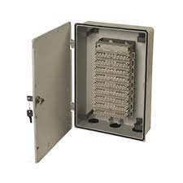
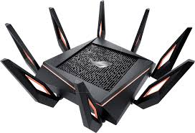
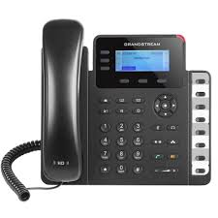
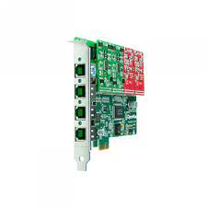
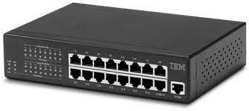
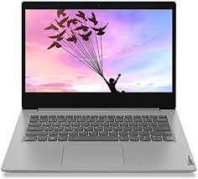
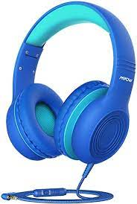
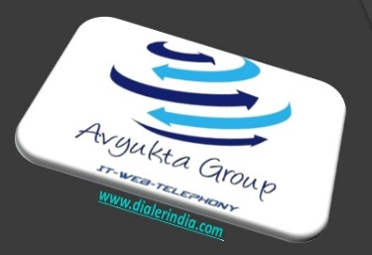
Call Flow And Architecture-Aajeevika
Old Architecture with Analog Line
Agent Floor
Analog Line
Wi-Fi
Router
Switch
FXO Card
Avyukta
Dialer
Server
Sales Force
USB Headphone
IP Phone
Soft Phone
Agent PC
Admin Quality/Supervisor/TL
25+ Reports
Voice Logs
Complete Recordings logs
Campaign Manager

Slide 8
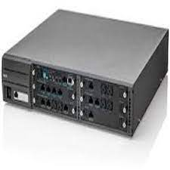
Call Flow And Architecture-Aajeevika
Existing Architecture with PRI Line
1800-1800-999 Inbound Calls from /to India PSTN Network
from / to PSTN Incoming Number
Call Backs /Outbound from PRI
Agent Floor
PRI Line
Wi-Fi
Router
Switch
PRI Card
Avyukta
Dialer
Server
Sales Force
USB Headphone
IP Phone
Soft Phone
Agent PC
Admin Quality/Supervisor/TL
25+ Reports
Voice Logs
Complete Recordings logs
Campaign Manager

Slide 9
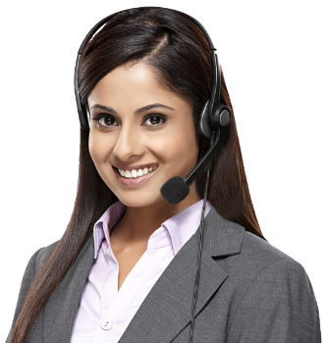
Political Elections / Campaigns
Insurance / Shares / Loan / DSA’s
Taxi Services / BPO / Collections
Survey / Appointment Setting / Lead generation
Astrology / Universities / Colleges
Recruitment / MIS / Placements / Admissions
Restaurant / Hotels / Customer Care
E com / Mobile Apps / Website
24 X 7 X 365 “Decade” of 1900+ Satisfied BPO’s
avyuktaindia
Predictive / Auto Dialer: Current Calls/ Output X 400%
Survey / Appointment Setting / Lead Generation
Domestic International Call Center / BPO Setup
Hosted / Premised / BPO / DoT VoIP / PRI / GSM Gateway
Smart IVR / Cloud Telephony / Omni Channel / CRM / API
OBD / Press 1/ Voice SMS / Masking / OTP / 1800
The Competition Assassinators
275+ Live Ref. Centres
11 Yrs. X Asterisks Dev.
9 Countries,91+ Cities
Live Demo / PoC
Lower than the Lowest Professional Bidder
All possible Techno-commercial models
No Blame Game : Your CTI-CRM-VoIP “SPOC”
100% Gov. Compliance
72 HR Refund Policy
10% Ref. discount/s
24X6 Support NoC
“The” single Answer to your
A to Z
Tel- ”e” - calling requirements
+1-408-791-3820
+91-856-00-00-600
sales@dialerindia.com
Avyukta Intellicall www.dialerindia.com

Slide 10
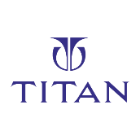
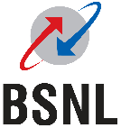
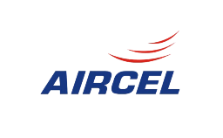
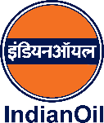
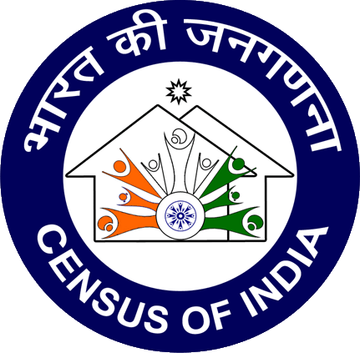
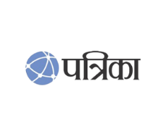
Trust over 11+ years
Some* Major Clients

Slide 11
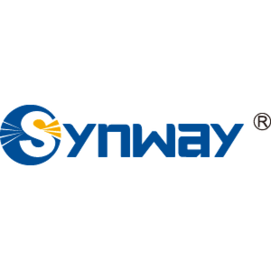
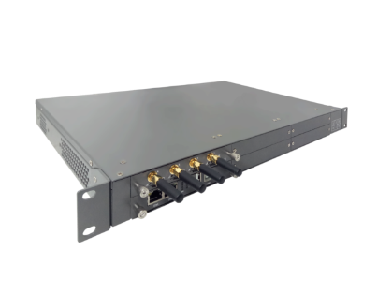
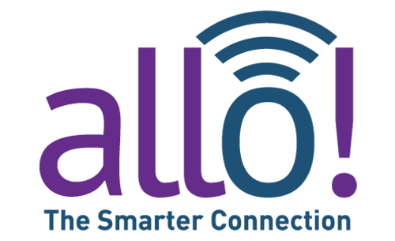
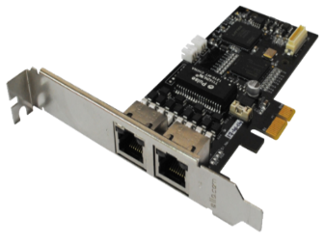
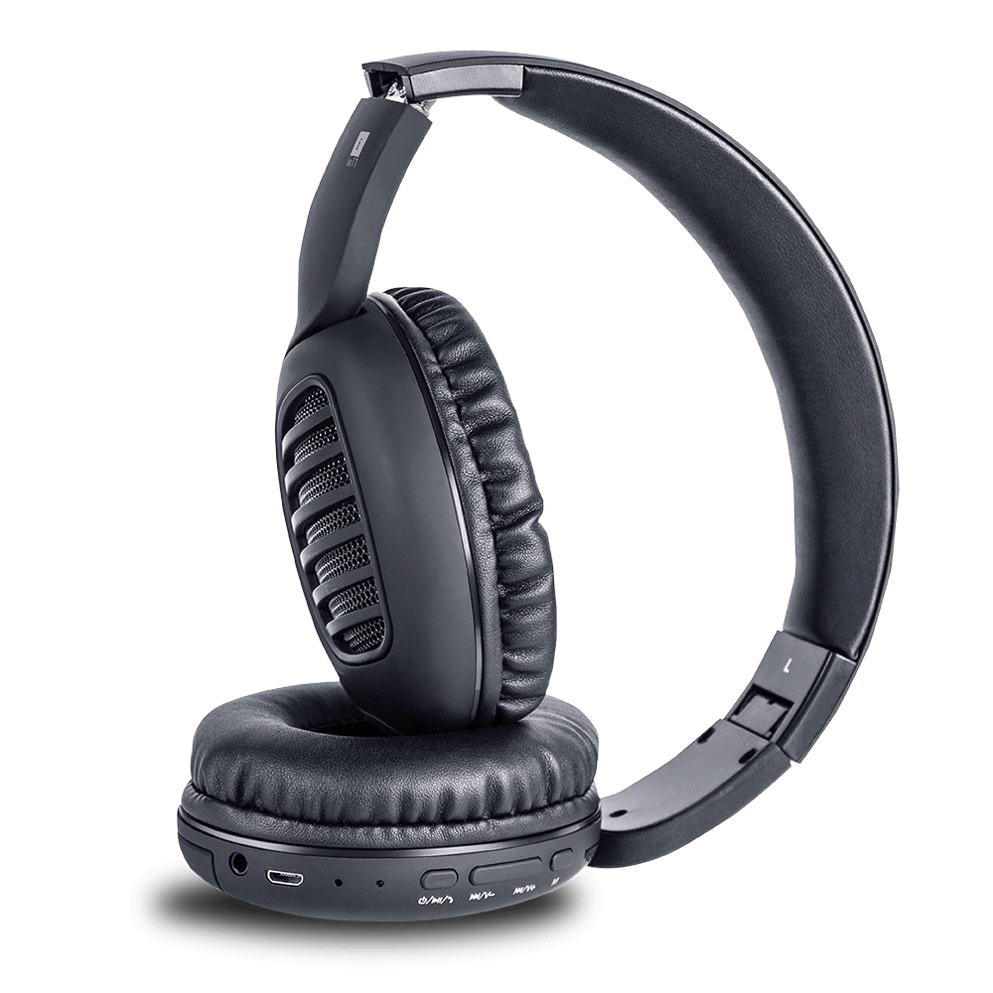
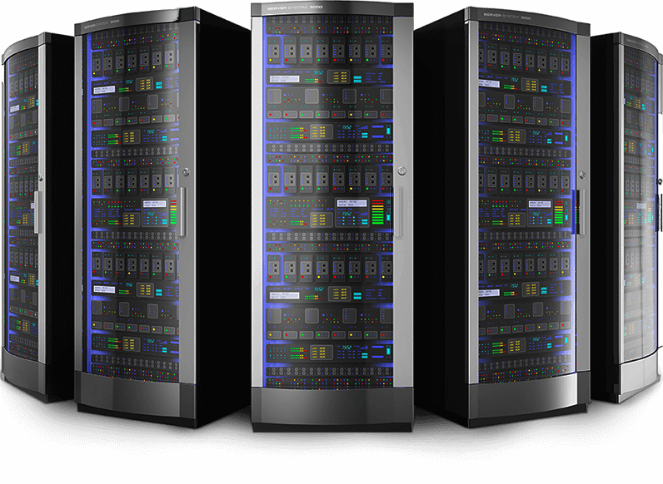
CTI Hardware Partners

Slide 12
Useful links
Domestic Architectures
International Architectures
Demo Video
Video Tutorials
Sample Voice Overs, Jingles and Melodies
DoT License / OSP Registration
PRI card / GSM Gateway / IP Phones / Headphone Buy Online
Vendor Comparison
Avyukta CRM Demo Video
Avyukta Sales CRM Demo Video
Avyukta Task CRM Demo Video
Avyukta Today CRM Demo Video
Request a Demo
Avyukta Client CRM Login
Support SLA
Avyukta on Youtube
Avyukta on Linkedin

Slide 13
Aajeevika Case Study
Thank You for Your Time

